Slide 1

From Enrollment to Engagement
Addressing Declines in TCU Institutions through Strategic Student Profiling
Wells Ling Ph.D. | Data Specialist

Slide 2
Today’s Goals
1
Review current enrollment trends
Improve recruitment and retention strategies
Develop demographic profile – Aaniiih Nakoda College
2
3

Slide 3
Current Enrollment Trends at TCUs

Slide 4
Fall enrollment has increased over the last 4 years across TCUs
Fall enrollment across TCUs has risen 18%
since hitting a record low in Fall 2020.*
*The lowest since data collection began in Fall 2004

Slide 5
But…enrollment has decreased/stagnated at several institutions
6%

Slide 6
This is problematic because…

Slide 7
…reductions in indigenous student enrollment reduces federal funds to TCUs by
$8,700 to $11,930
per Indigenous student annually
as a part of the Tribally Controlled Colleges and Universities Assistance Act of 1978.
Notes:
…declining enrollment impacts TCU budgets as reductions in indigenous student enrollment reduces federal funds to TCUs by $8,700 to $11,930 per Indigenous student annually as a part of the Tribally Controlled Colleges and Universities Assistance Act of 1978.

Slide 8
What can we do about it?

Slide 9

Improved
Recruitment
Retention
through demographic profiling

Slide 10
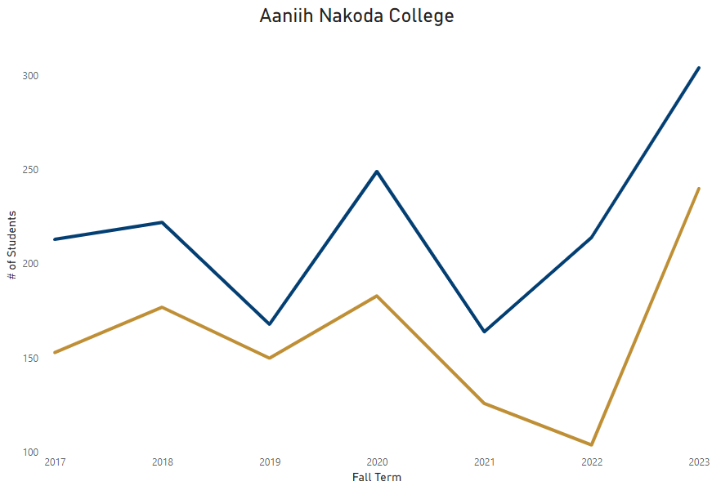
Using AIMS data, we can build a profile of the typical student…
…more female
Female
304
Male
240
Notes:
For example:
Gender

Slide 11
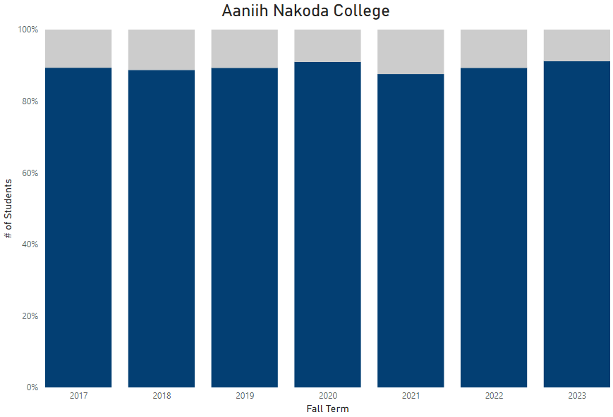
Using AIMS data, we can build a profile of the typical student…
…more AI/AN
AI/AN % of Total Enrollment
Female
Notes:
For example:
Gender

Slide 12
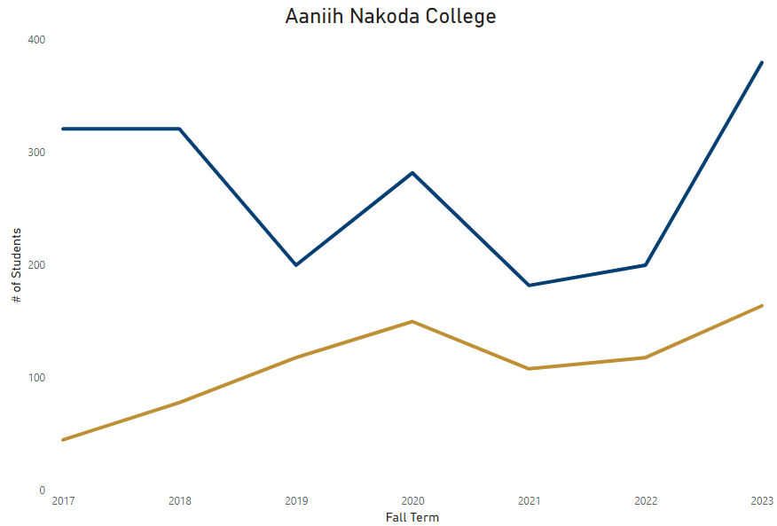
Using AIMS data, we can build a profile of the typical student…
…increasingly more full-time
Full-Time
380
Female
Part-Time
164
AI/AN
Notes:
For example:
Gender

Slide 13
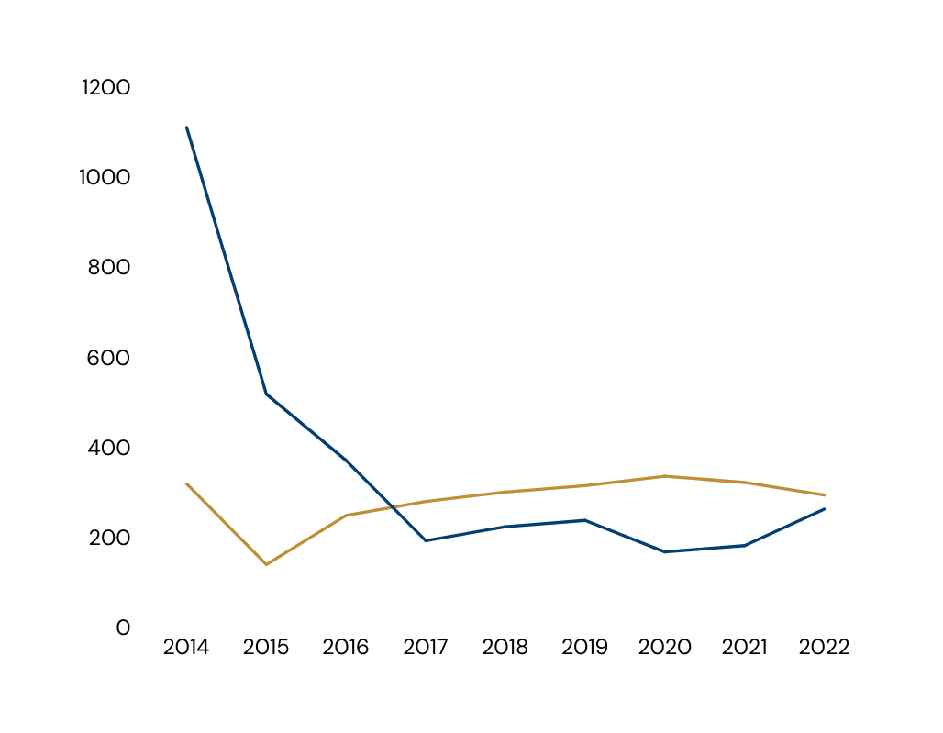
Using AIMS data, we can build a profile of the typical student…
…increasingly non-traditional
Aaniiih Nakoda College
Female
# of Students
Traditional
294
AI/AN
Non-Traditional
259
Fall
Increasingly Full-Time
Notes:
For example:
Gender

Slide 14
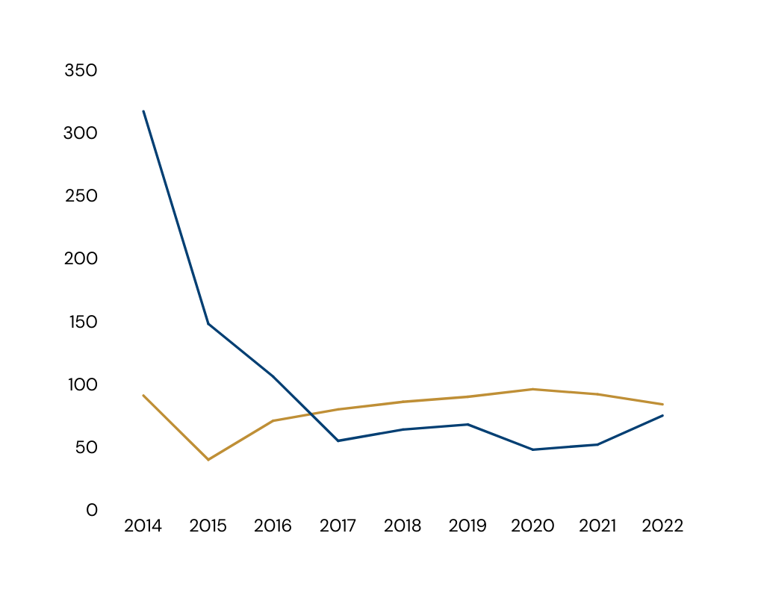
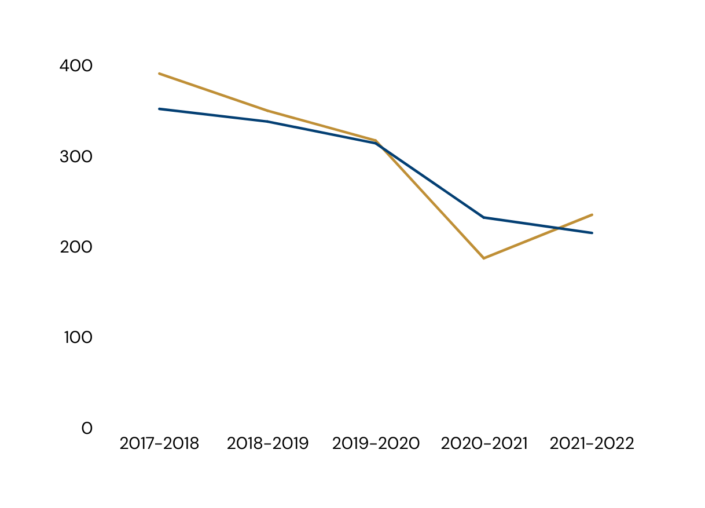
Using AIMS data, we can build a profile of the typical student…
Aaniiih Nakoda College
Female
Increasingly Non-Traditional
Certificate
235
# of Students
Associates
215
AI/AN
Academic Year
…increasingly certificate seeking
Increasingly Full-Time
Notes:
For example:
Gender

Slide 15
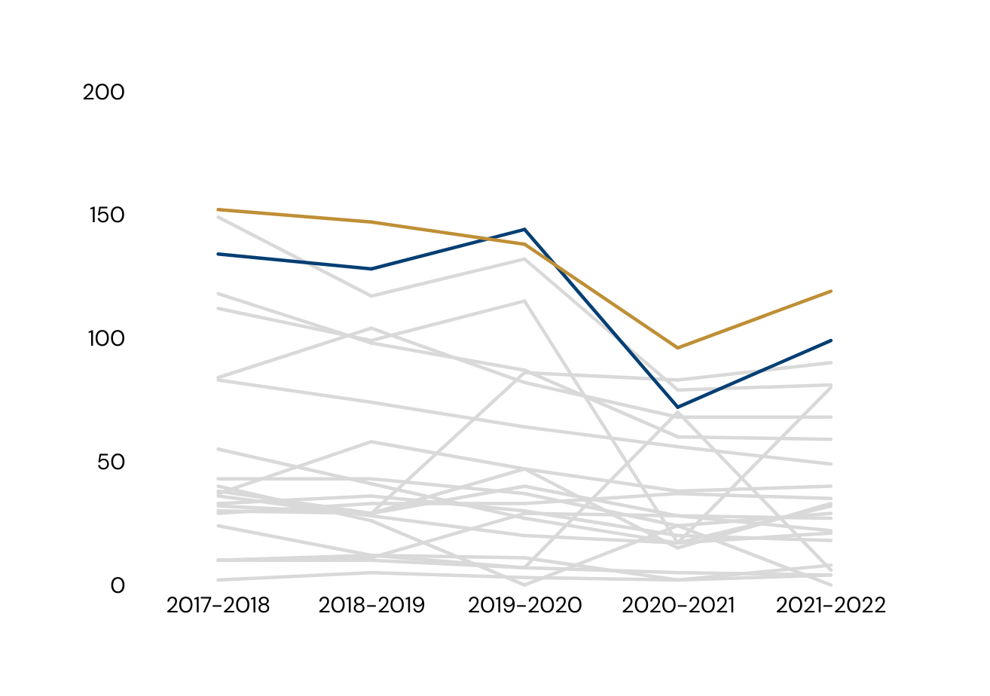
Using AIMS data, we can build a profile of the typical student…
Aaniiih Nakoda College
Female
Increasingly Non-Traditional
Education
119
# of Students
Business
99
AI/AN
Increasingly Certificate Seeking
Academic Year
…more education and business students
Increasingly Full-Time
Notes:
For example:
Gender

Slide 16
Using this profile, focus recruitment and retention towards students with the following traits:
Female
Indigenous
Full-Time
Non-traditional (25+)
Pursuing a Certificate in Education or Business
Notes:
Recruitment strategies:
- Recruit within the Indigenous community centers where non-traditional individuals may frequent (so less high schools)
Culturally relevant marketing: highlight indigenous traditions and values in materials and highlight cultural opportunities on campus.
Offer flexible learning option that accommodate the unique needs of non-trade students who may have family commitments
Offer support services specifically tailored to those in education and business such as networking opportunities or invited talks from leaders in the business and education field
Seeking out partnerships with local school districts and business to offer internships within education and business

